Slide 1
The Processor
Dr. Rajib Ranjan Maiti
CSIS, BITS-Pilani, Hyderabad
Disclaimer: To know the complete syllabus, handout and the text book should be consulted

Slide 2
A Basic MIPS Implementation
We shall examine an implementation of some of MIPS instructions
load word (lw) and store word (sw)
Arithmetic: add, sub, AND, OR, and slt
branch equal (beq) and jump (j)
Our focus
the key principles used in creating a datapath and designing the control
How the instruction set architecture determines different aspects of the implementation?
How the implementation affects the clock rate and CPI for the computer?

Slide 3
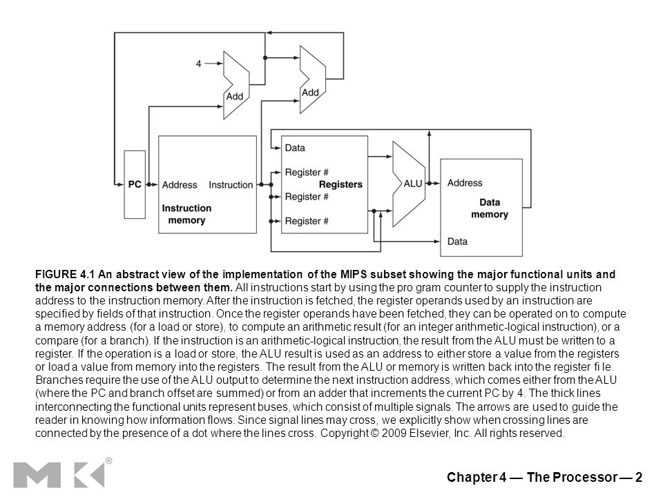
MIPS implementation: functional units and their interconnection

Slide 4
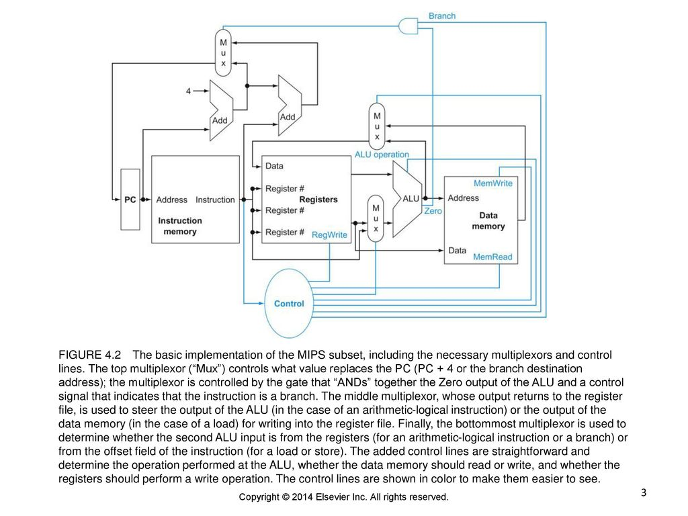
The datapath of MIPS implementation

Slide 5
Logic Design Conventions
Two questions
how the hardware logic will operate?
how the computer is clocked?
two different types of logic elements:
elements that operate on data values : combinational, which means that their outputs depend only on the current inputs, e.g., ALU
elements that contain state: contain state, i.e., it has some internal storage, e.g., the instruction and data memories, as well as the registers
In addition to flip-flops, MIPS implementation uses
two other types of state elements: memories and registers,

Slide 6
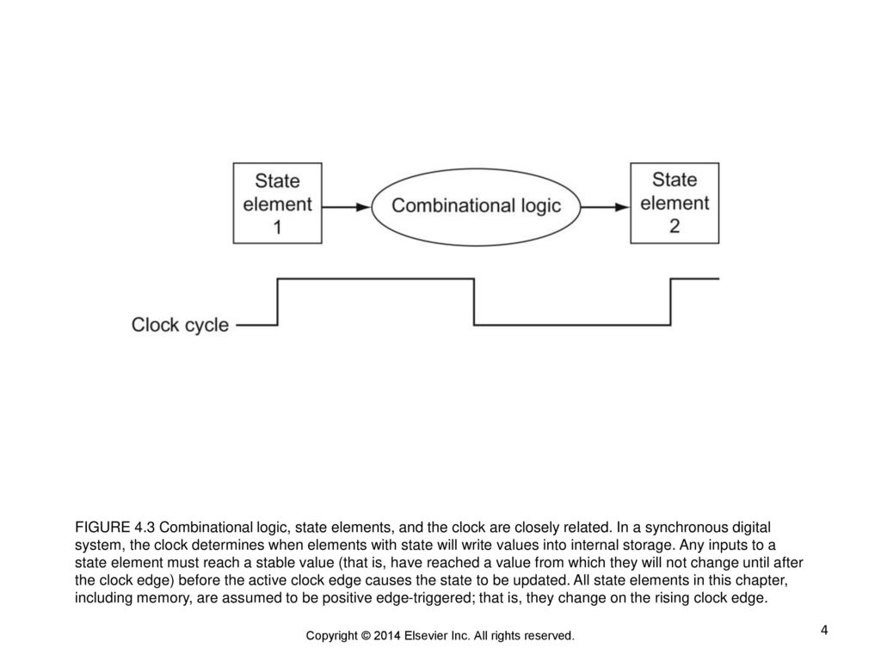
Logic Design Conventions
At any time, the clock is used to determine
when the state element should be written or
a state element can be read
Clocking Methodology defines
when signals can be read and when they can be written
We will assume an edge-triggered clocking methodology, i.e.,
any values stored in a sequential logic element are updated only on a clock edge
Because only state elements can store a data value, any collection of combinational logic must have its inputs come from a set of state elements and its outputs written into a set of state elements
The inputs are values that were written in a previous clock cycle, while the outputs are values that can be used in a following clock cycle

Slide 7
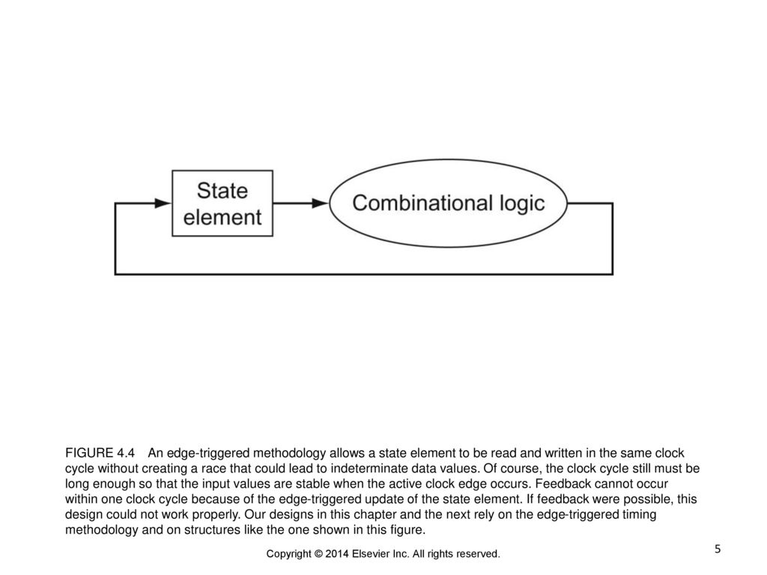
Finally, color indicates a control signal as opposed to a signal that carries data

Slide 8
Building a Datapath

Slide 9
Datapath for Instruction fetch
to start a datapath design
examine the major components required to execute each class of MIPS instructions
Some Components are required for every instruction : instruction fetch
A memory unit
stores the instructions of a program
supplies an instruction given an address
The program counter (PC)
a register that holds the address of the current instruction
An adder
to increment the PC to the address of the next instruction

Slide 10
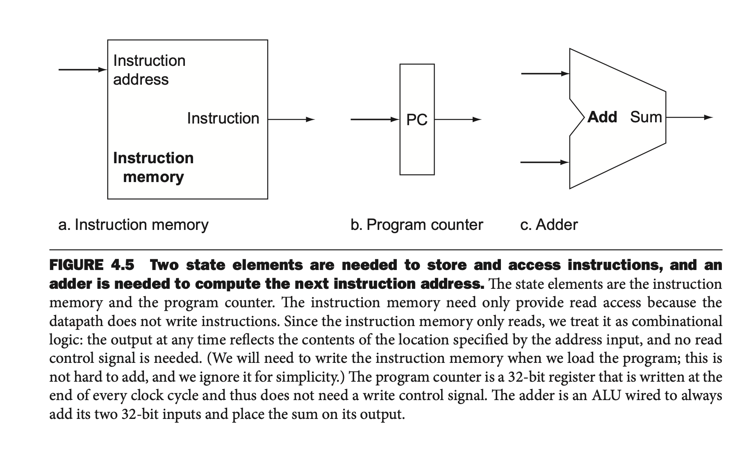

Slide 11
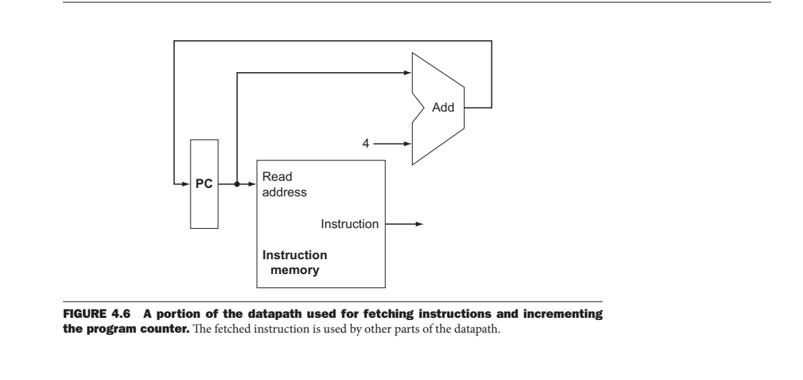
How do we combine these datapath elements?

Slide 12
Building a Datapath: Execution of R-Type instruction
The task
Read two registers,
perform an ALU operation on the contents of the registers, and
write the result to a register
Example of R-Type instructions
add, sub, AND, OR, and slt
MIPS elements
32 general-purpose registers are stored in a structure called a register file
An ALU to operate on the values read from the registers

Slide 13
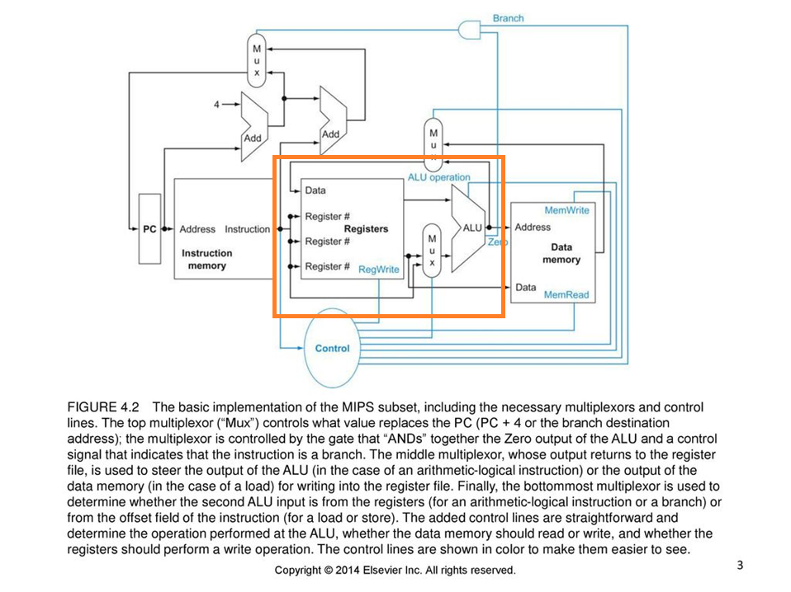

Slide 14
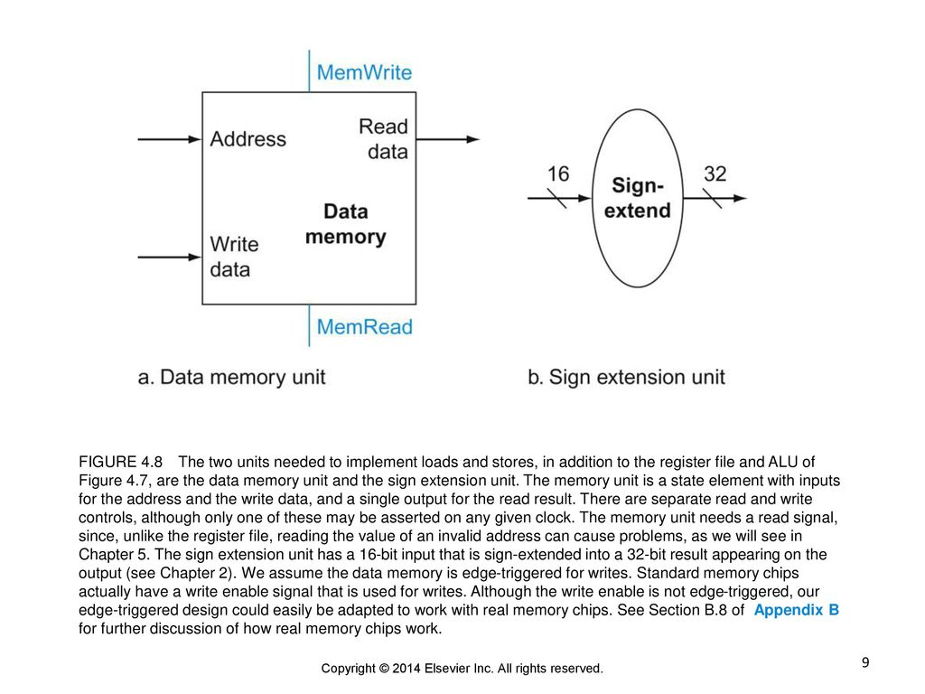
Building a Datapath: Execution of Load and Store
MIPS elements
the register file
the ALU
a unit to sign-extend the 16-bit off set field in the instruction to a 32-bit signed value,
a data memory unit

Slide 15
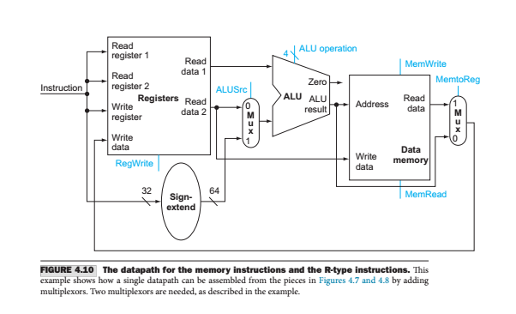

Slide 16
Building a Datapath: Branch instruction

Slide 17
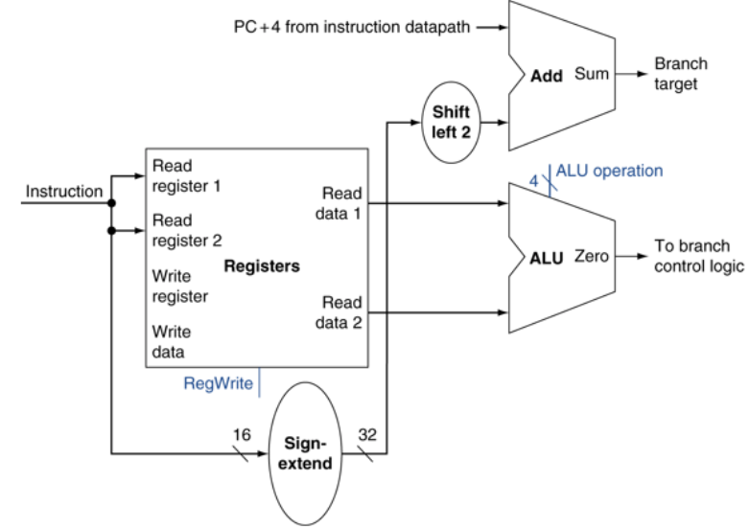
Building a Datapath: Branch instruction
Reverse to Compute Label:
Temp1 = Branch Target – (PC + 4)
Temp2 = RightShift2 (temp1)
Label = SignReduce16(Temp2)

Slide 18
Building a Datapath: Jump instruction
The jump instruction
operates by replacing the lower 28 bits of the PC with the lower 26 bits of the instruction shifted left by 2 bits
Simply concatenating 00 to the jump off set accomplishes this shift

Slide 19
Creating a Single Datapath: Memory and R-Type
This simplest datapath will attempt to execute all instructions in one clock cycle.
This means that no datapath resource can be used more than once per instruction,
So, any element needed more than once must be duplicated

Slide 20
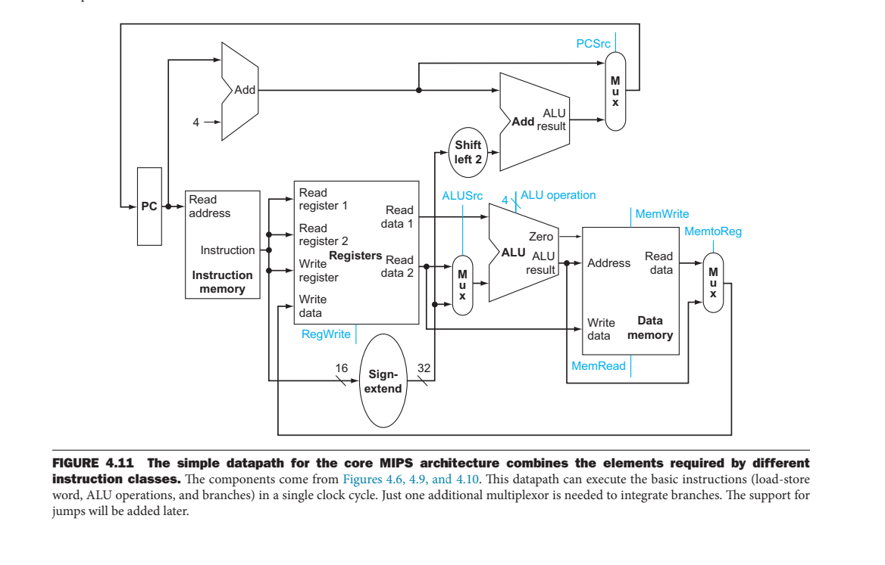
Detailed MIPS Architecture

Slide 21
A Simple Implementation Scheme

Slide 22
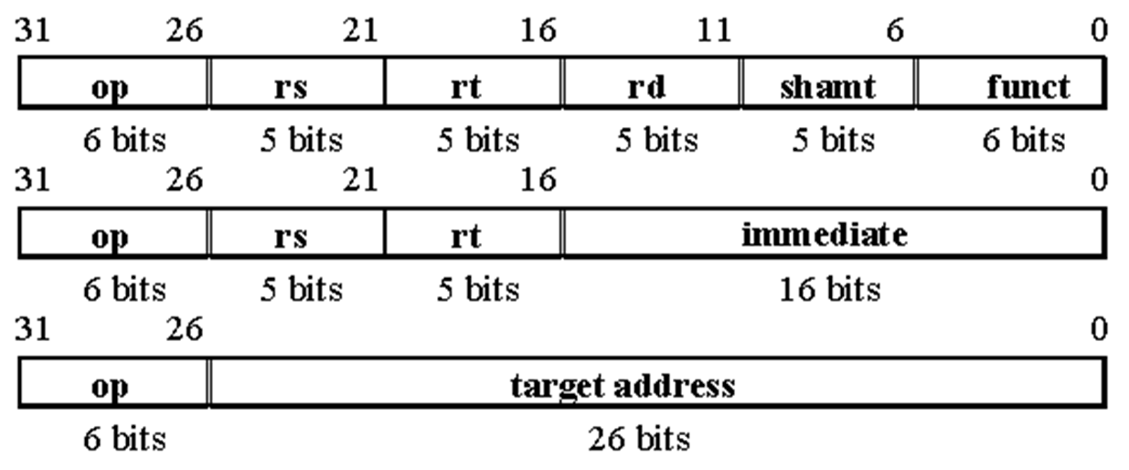
An implementation of our MIPS subset
The MIPS ALU defines the 6 following combinations of four control inputs:
Depending on the instruction class, the ALU needs to perform one of the first five functions
For the R-type instructions,
the ALU needs to perform one of the five actions (AND, OR, subtract, add, or set on less than),
The actions depends on 6-bit funct (or function) value
ALU control lines | Function
0000 | AND
0001 | OR
0010 | Add
0110 | Subtract
0111 | set on less than
1100 | NOR

Slide 23
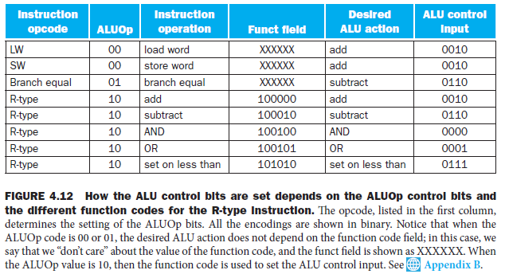

Slide 24
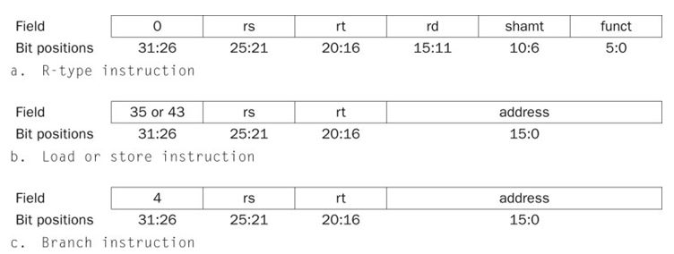
Designing the Main Control Unit
let’s identify the fields of an instruction and the control lines that are needed for the datapath we constructed

Slide 25
Review the formats of the three instruction classes
The op field, also called the opcode,
always contained in bits 31:26
The two registers to be read
always specified by the rs (25:21) and rt (20:16) fields
This is true for the R-type instructions, branch equal, and store
The base register for load and store instructions
always in rs (25:21)
The 16-bit off set for branch equal, load, and store
always in positions 15:0
The destination register
one of two places
For a load it is in bit positions 20:16 (rt),
for an R-type instruction it is in bit positions 15:11 (rd)
Therefore, we will need to add a multiplexor

Slide 26
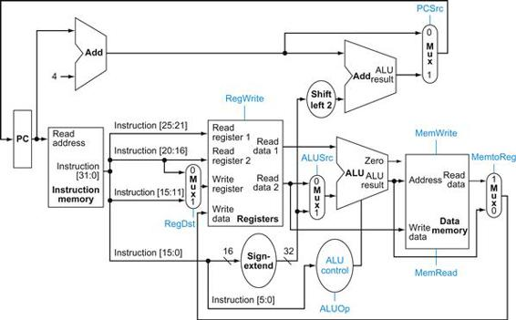
The Datapath
seven single-bit control lines plus the 2-bit ALUOp control
signal

Slide 27
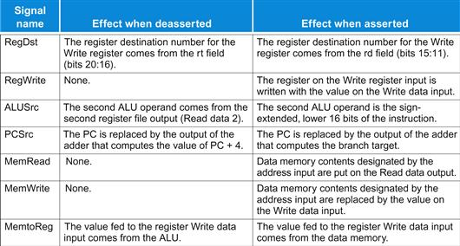
7 control lines

Slide 28
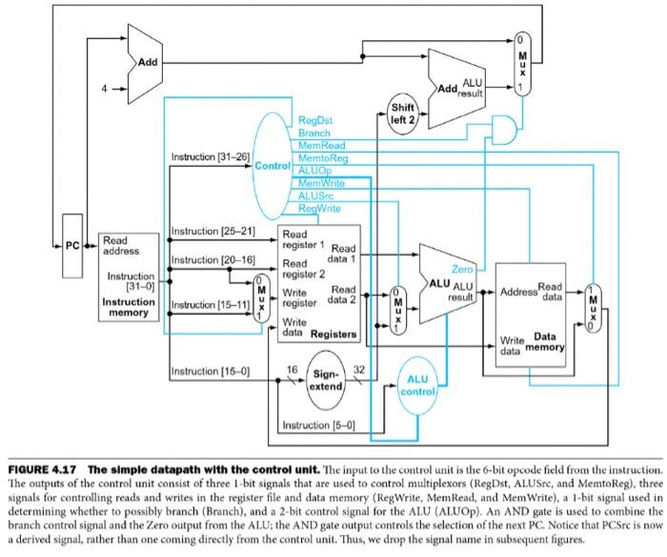
Datapath with control lines

Slide 29
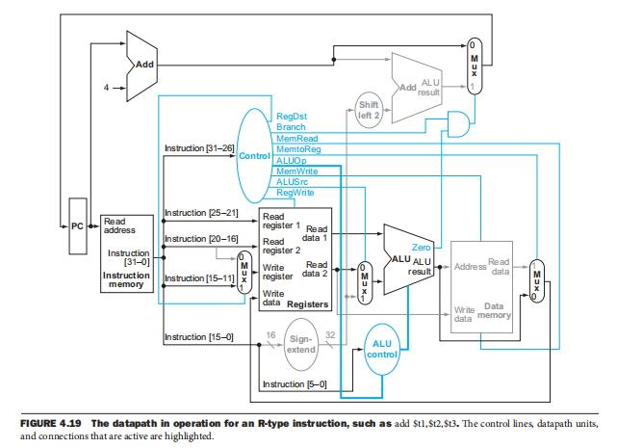
everything occurs in one clock cycle

Slide 30
Operation of the Datapath
How about the execution of a load word, such as
lw $t1, offset($t2)
a load instruction is operating in five steps
An instruction is fetched from the instruction memory, and the PC is incremented
A register ($t2) value is read from the register file
The ALU computes the sum of the value read from the register file and the sign-extended, lower 16 bits of the instruction (offset)
The sum from the ALU is used as the address for the data memory
The data from the memory unit is written into the register file; the register destination is given by bits 20:16 of the instruction ($t1)

Slide 31
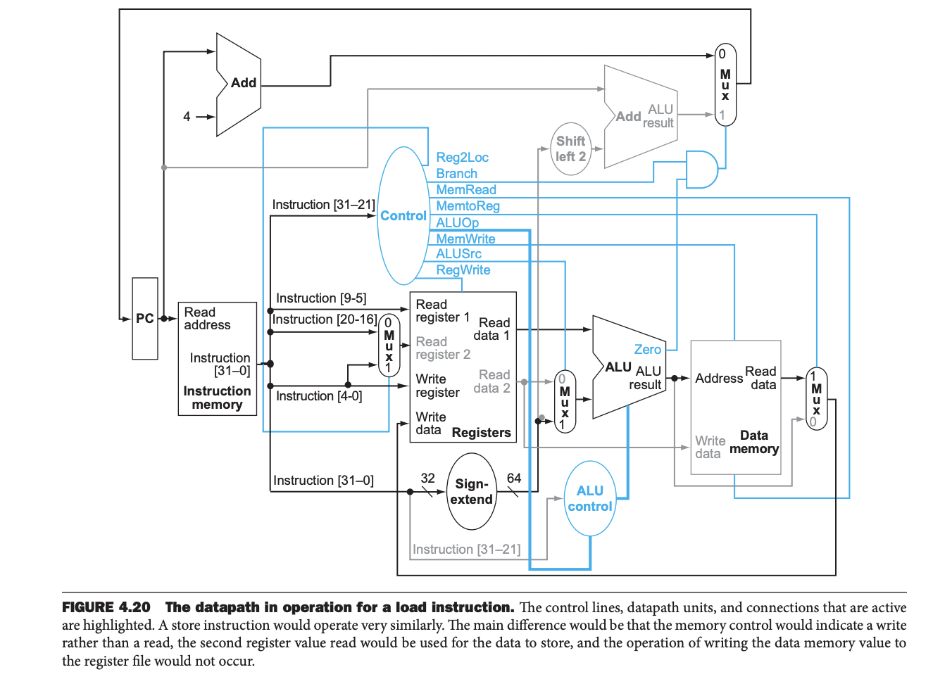

Slide 32
Operation of the Datapath
How about the execution of a beq, such as
beq $t1, $t2, offset
a beq instruction is operating in four steps
An instruction is fetched from the instruction memory, and the PC is incremented
Two registers, $t1 and $t2, are read from the register file
The ALU performs a subtract on the data values read from the register file
The value of PC + 4 is added to the sign-extended, lower 16 bits of the instruction (offset) shifted left by two; the result is the branch target address
The Zero result from the ALU is used to decide which adder result to store into the PC

Slide 33
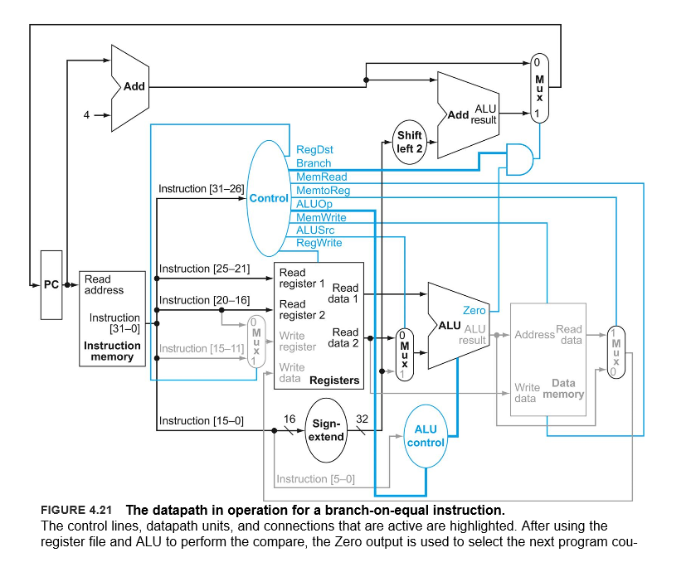
Data path for beq t1, t2, offset

Slide 34
let’s add the jump instruction to show how the basic datapath and control can be extended

Slide 35
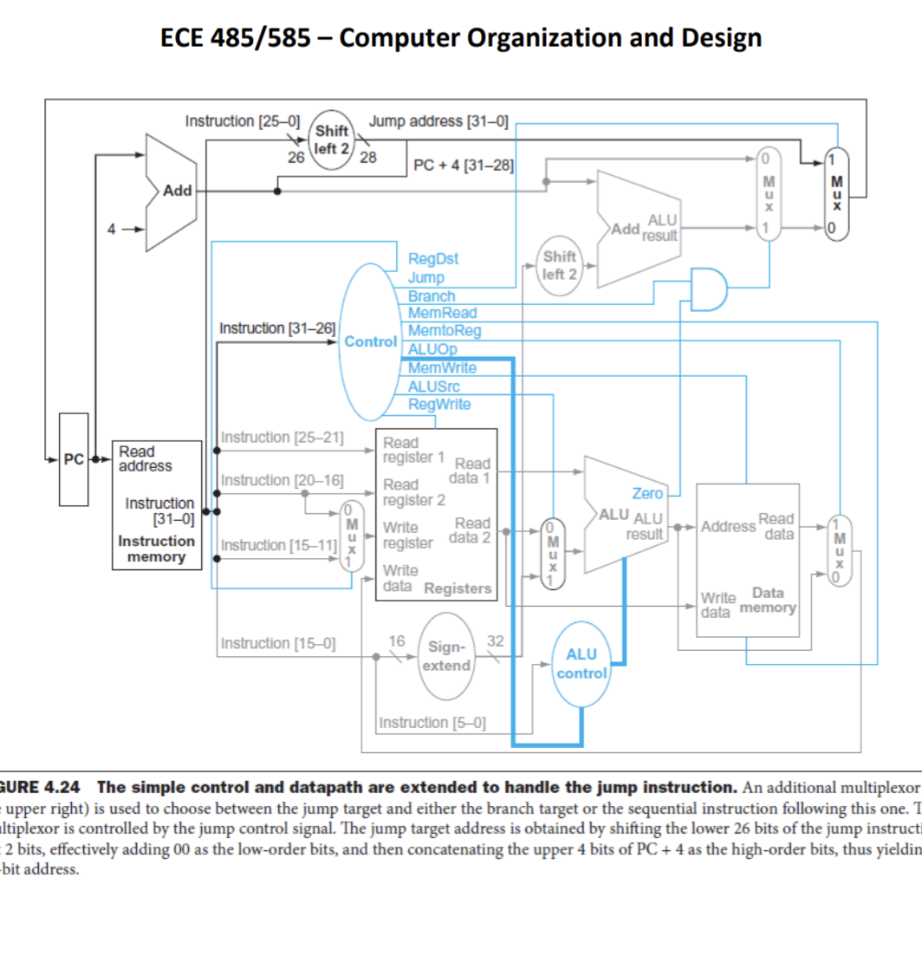
Datapath for j address

Slide 36


